Slide 1
Azure Blob>ADF>ADLS
In this we are going to move data to initial source to intermediate layers ie like azure blob to ADLS or ADLS to ADLS (This is used when client put data in one storage and you want to pull only specific data and put it in separate container)
(SQL is final Target table so connect to BI technology tools)

Slide 2
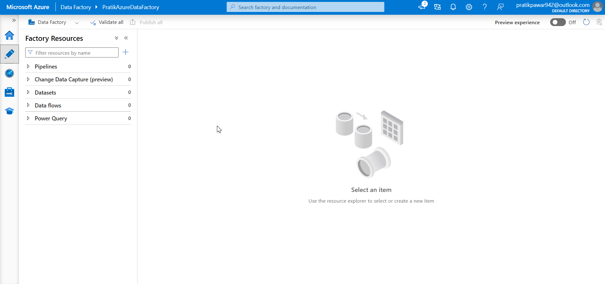
First Create Azure Blob Storage , ADF and ADLS

Slide 3
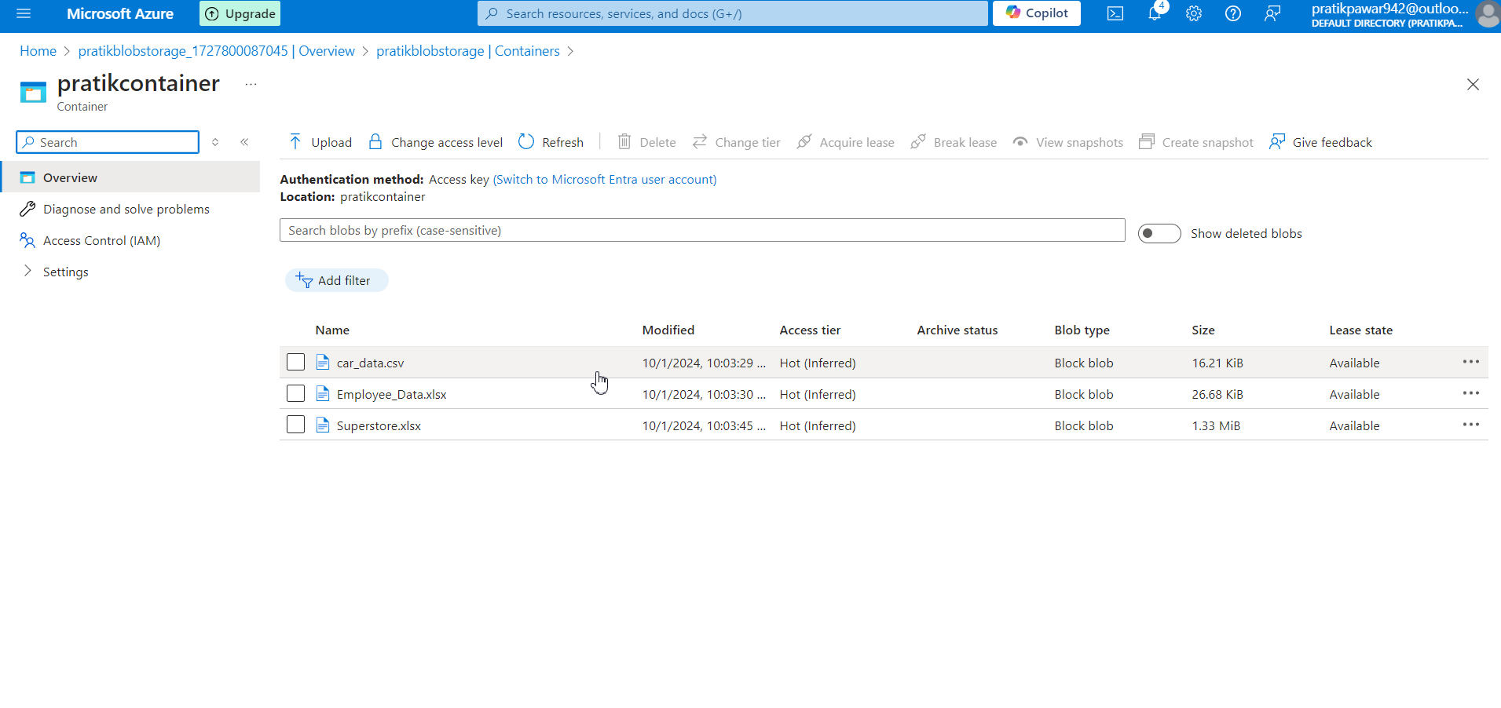
Now we have to move this files from one container to another ie ADLS

Slide 4
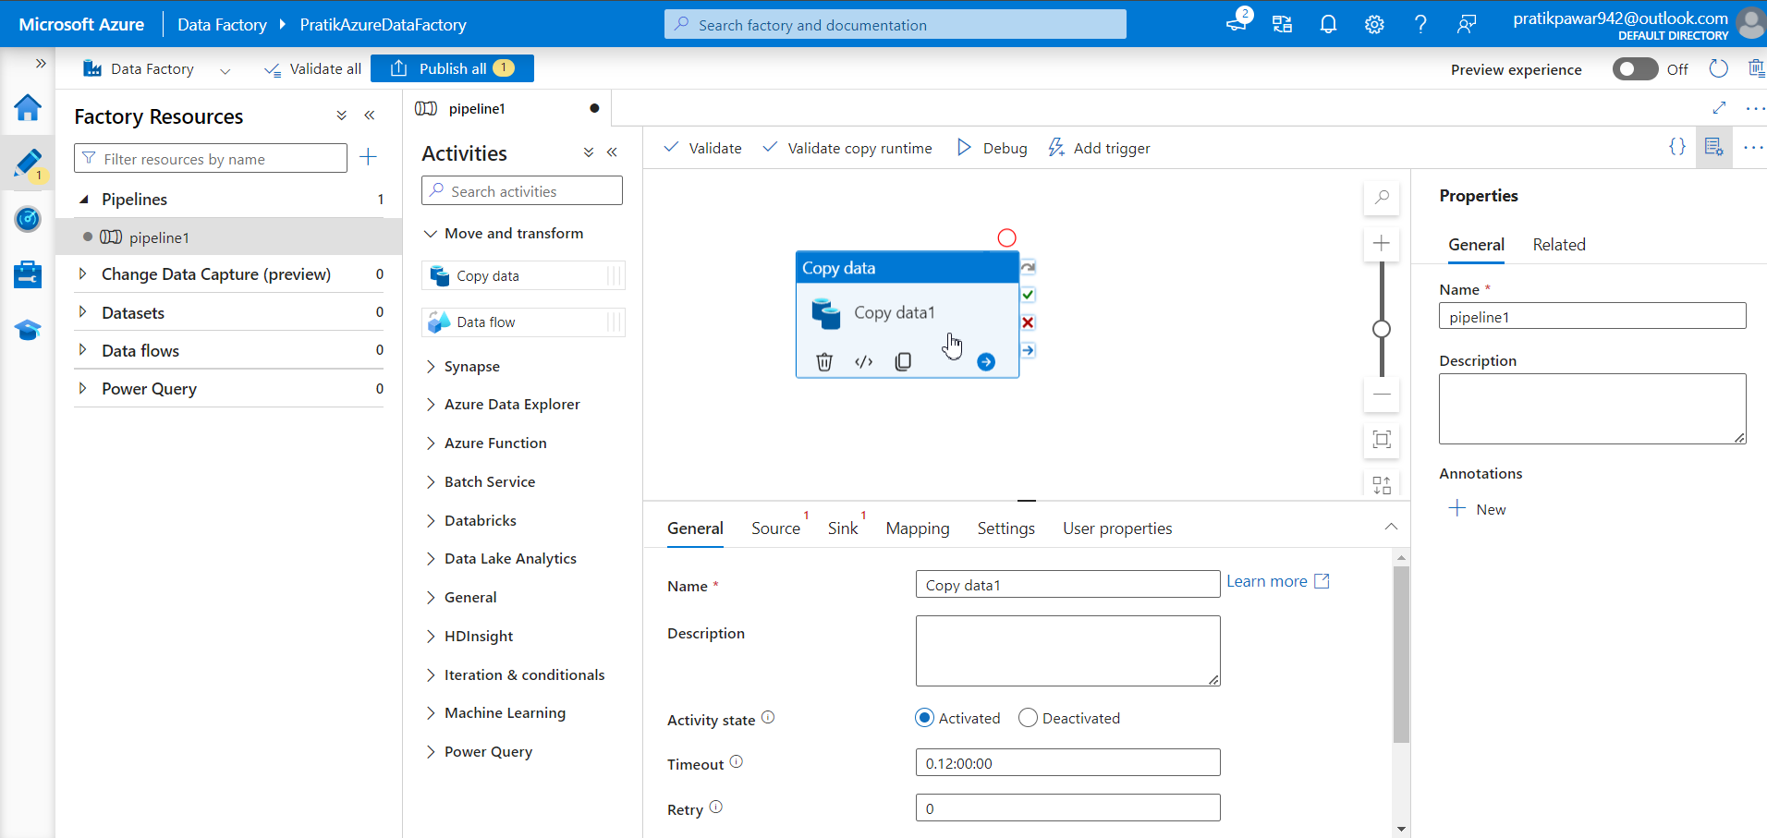
Go to ADF and Copy Data Activity

Slide 5
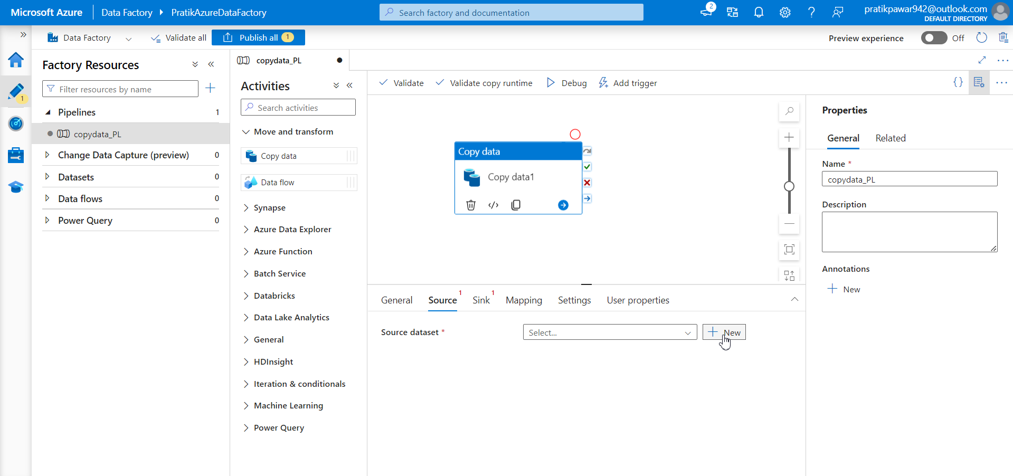
Now add source as Azure Blob Storage and Sink as ADLS

Slide 6
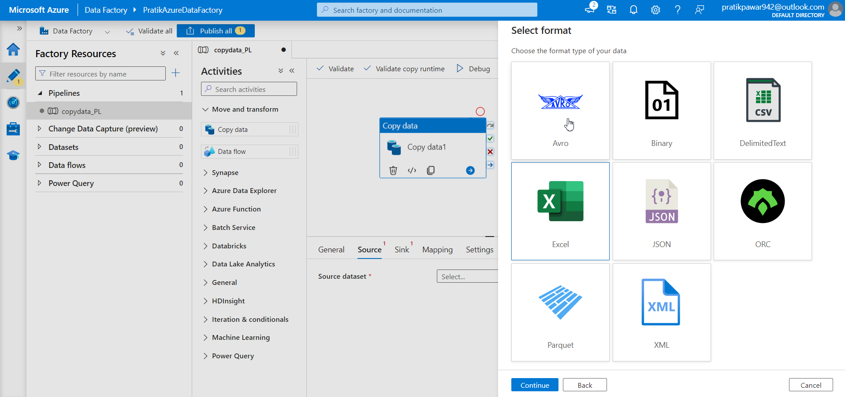
We can choose any Format as .csv ie Delimited Text

Slide 7
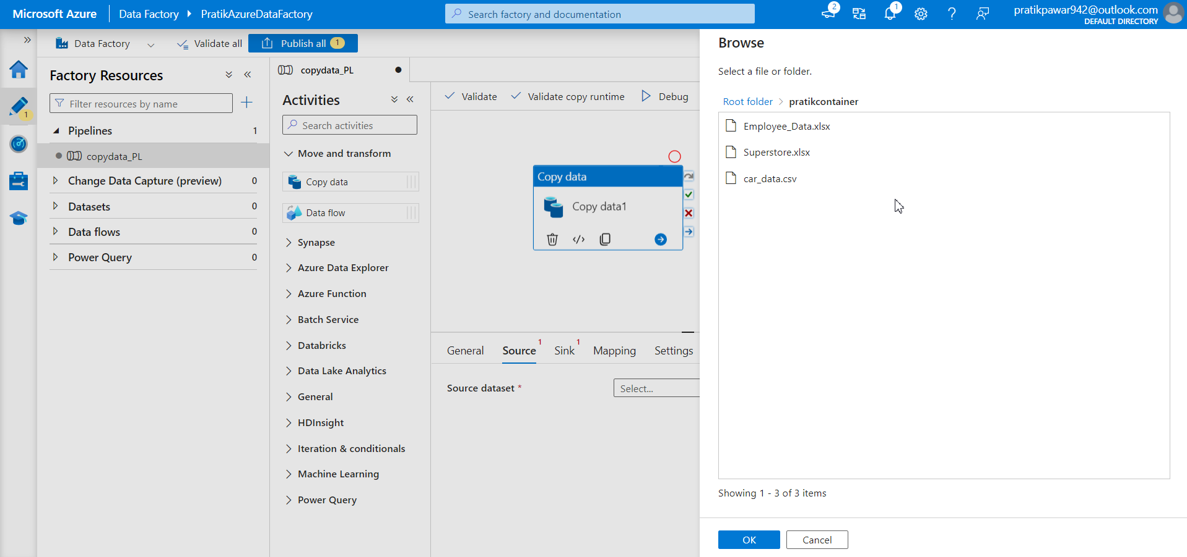
We have to move all the data and not any particular file. So now just select any of data file

Slide 8
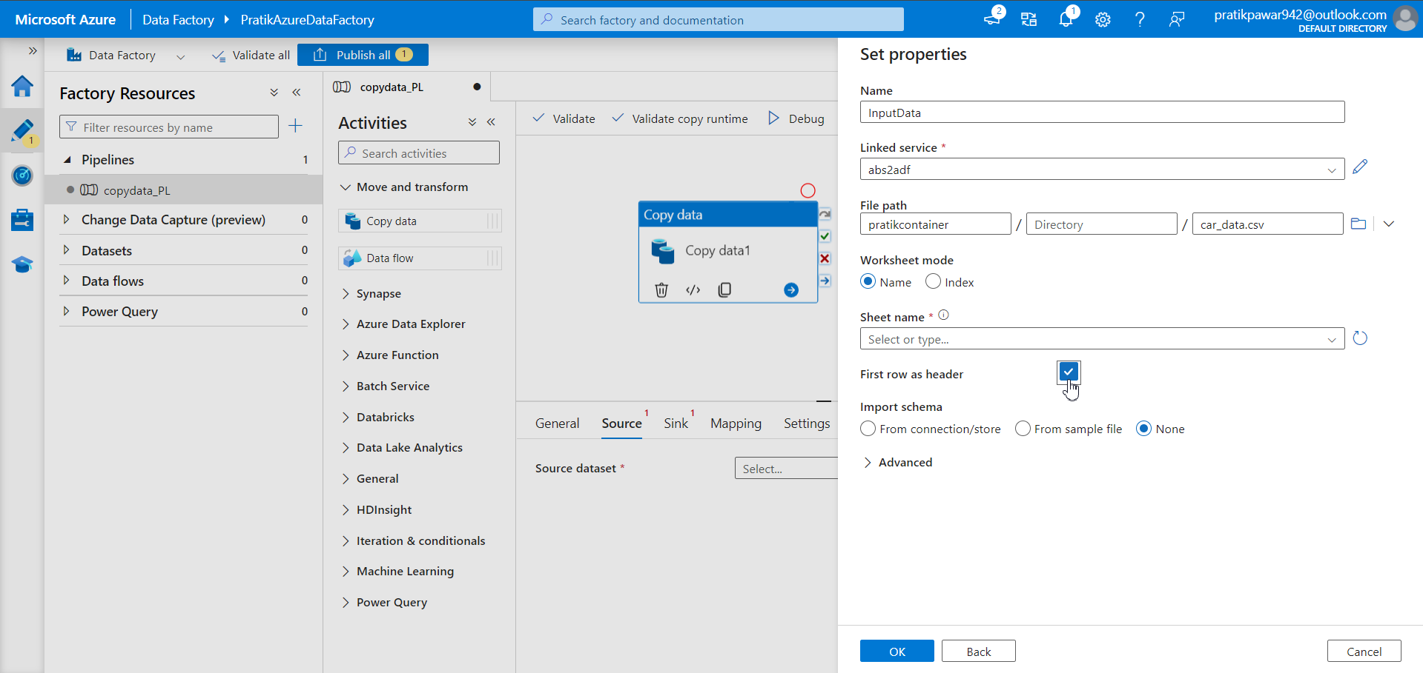
First Row as header and ok

Slide 9
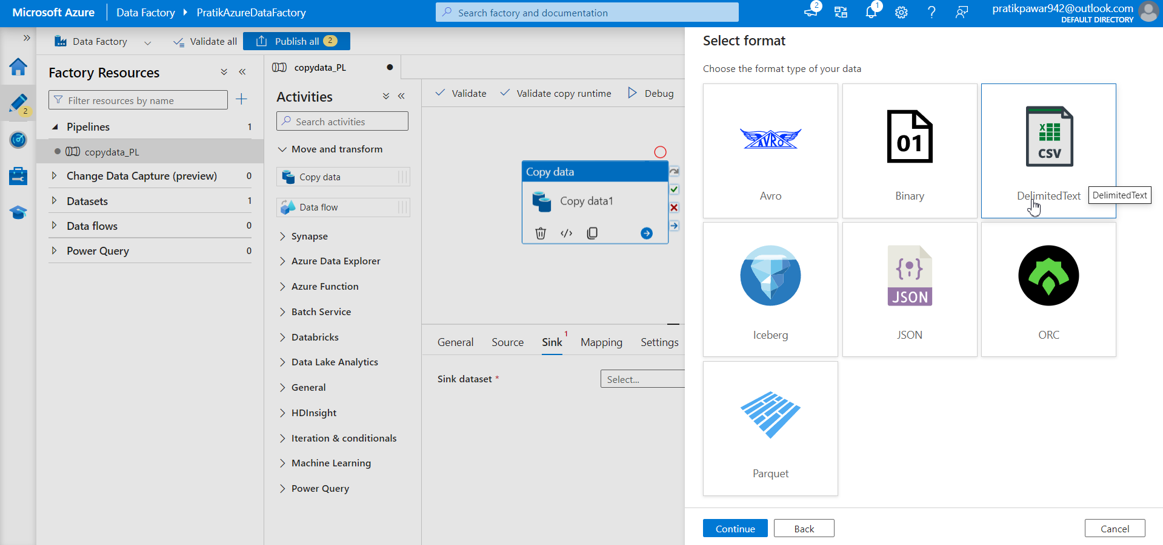
Now create sink and format as .csv ie Delimited Text

Slide 10
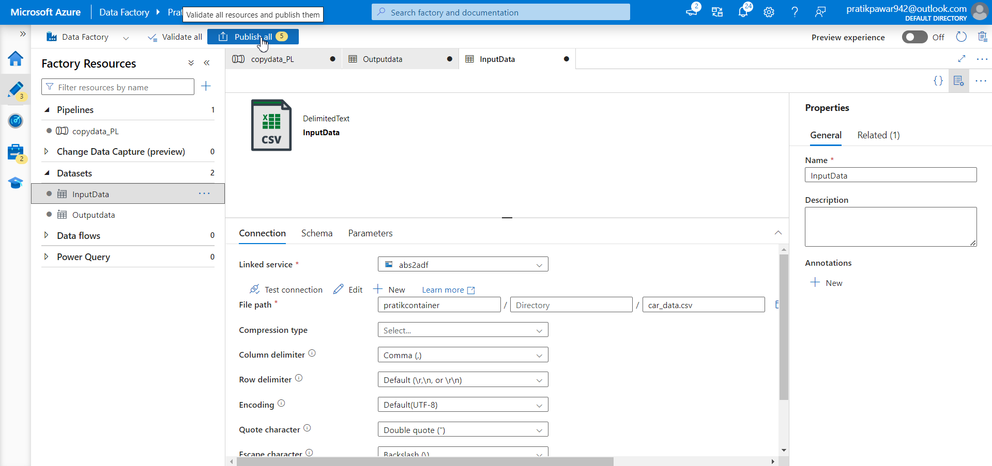
Publish

Slide 11
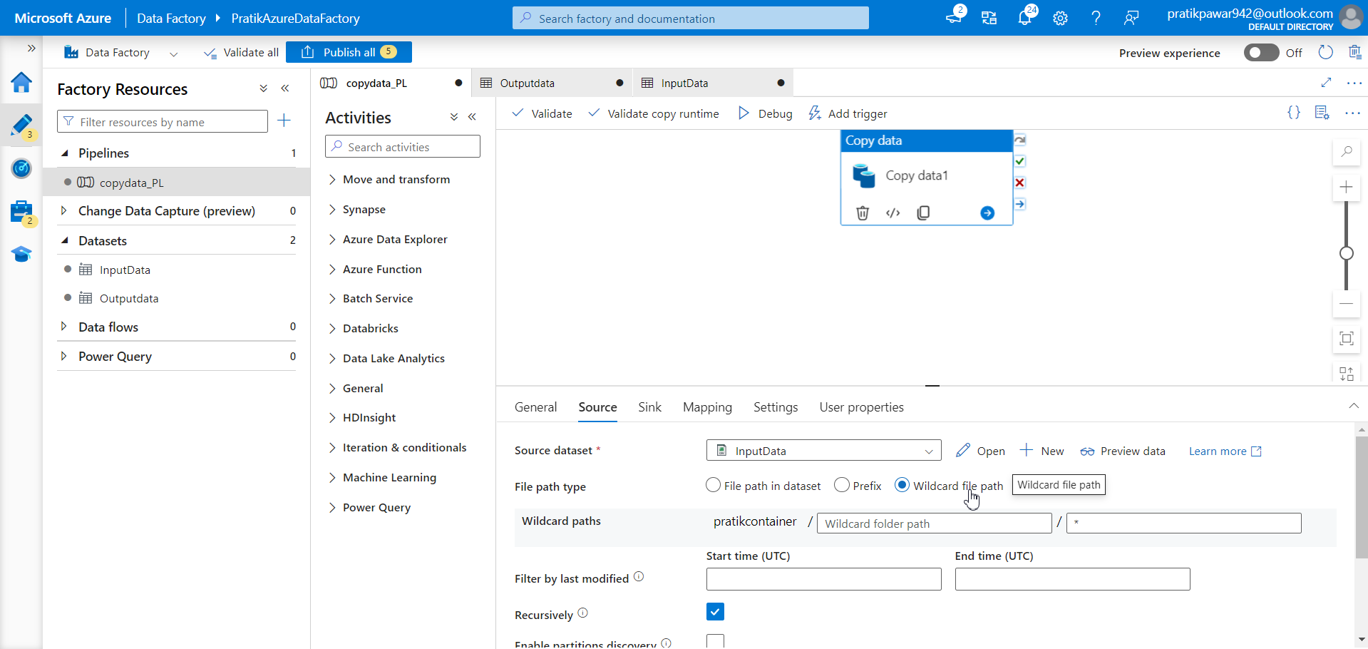
Now go to pipeline>File Path Type Choose Wildcard File Path(wildcards can be used in dataset definitions to pull in multiple files that follow a pattern, making it easier to process large numbers of files from a storage location like Azure Blob Storage or Data Lake.)

Slide 12
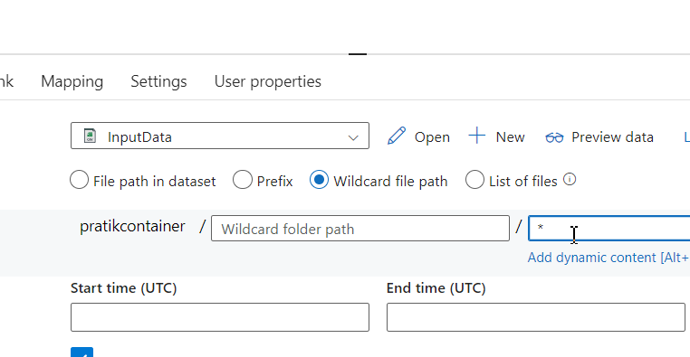
Now in wild card file name enter * so it will include every type of file (.xlsx, .csv, .json, .xml, etc)(if we put *csv then only csv files will come)

Slide 13
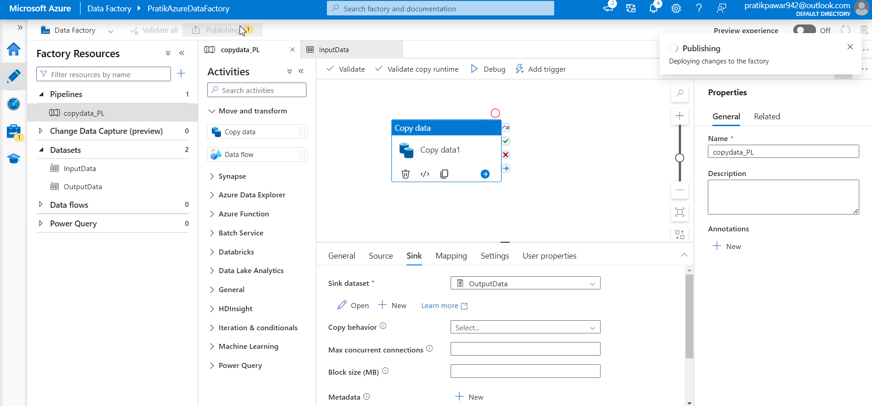
Publish

Slide 14
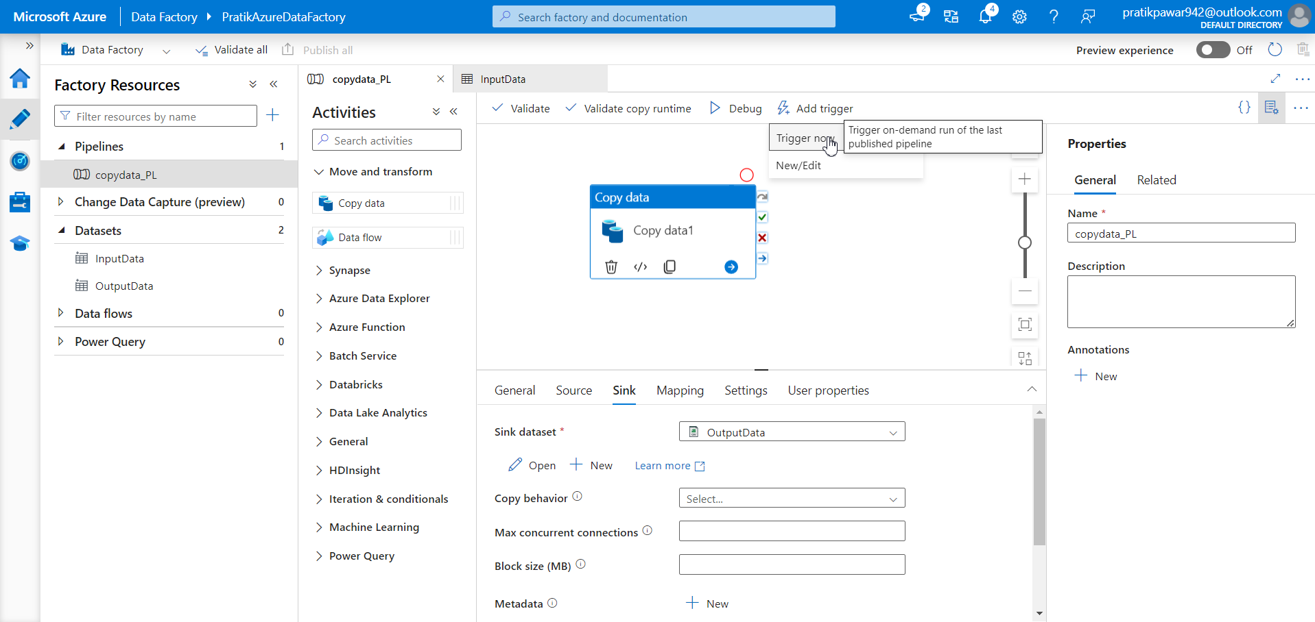
Trigger Now

Slide 15
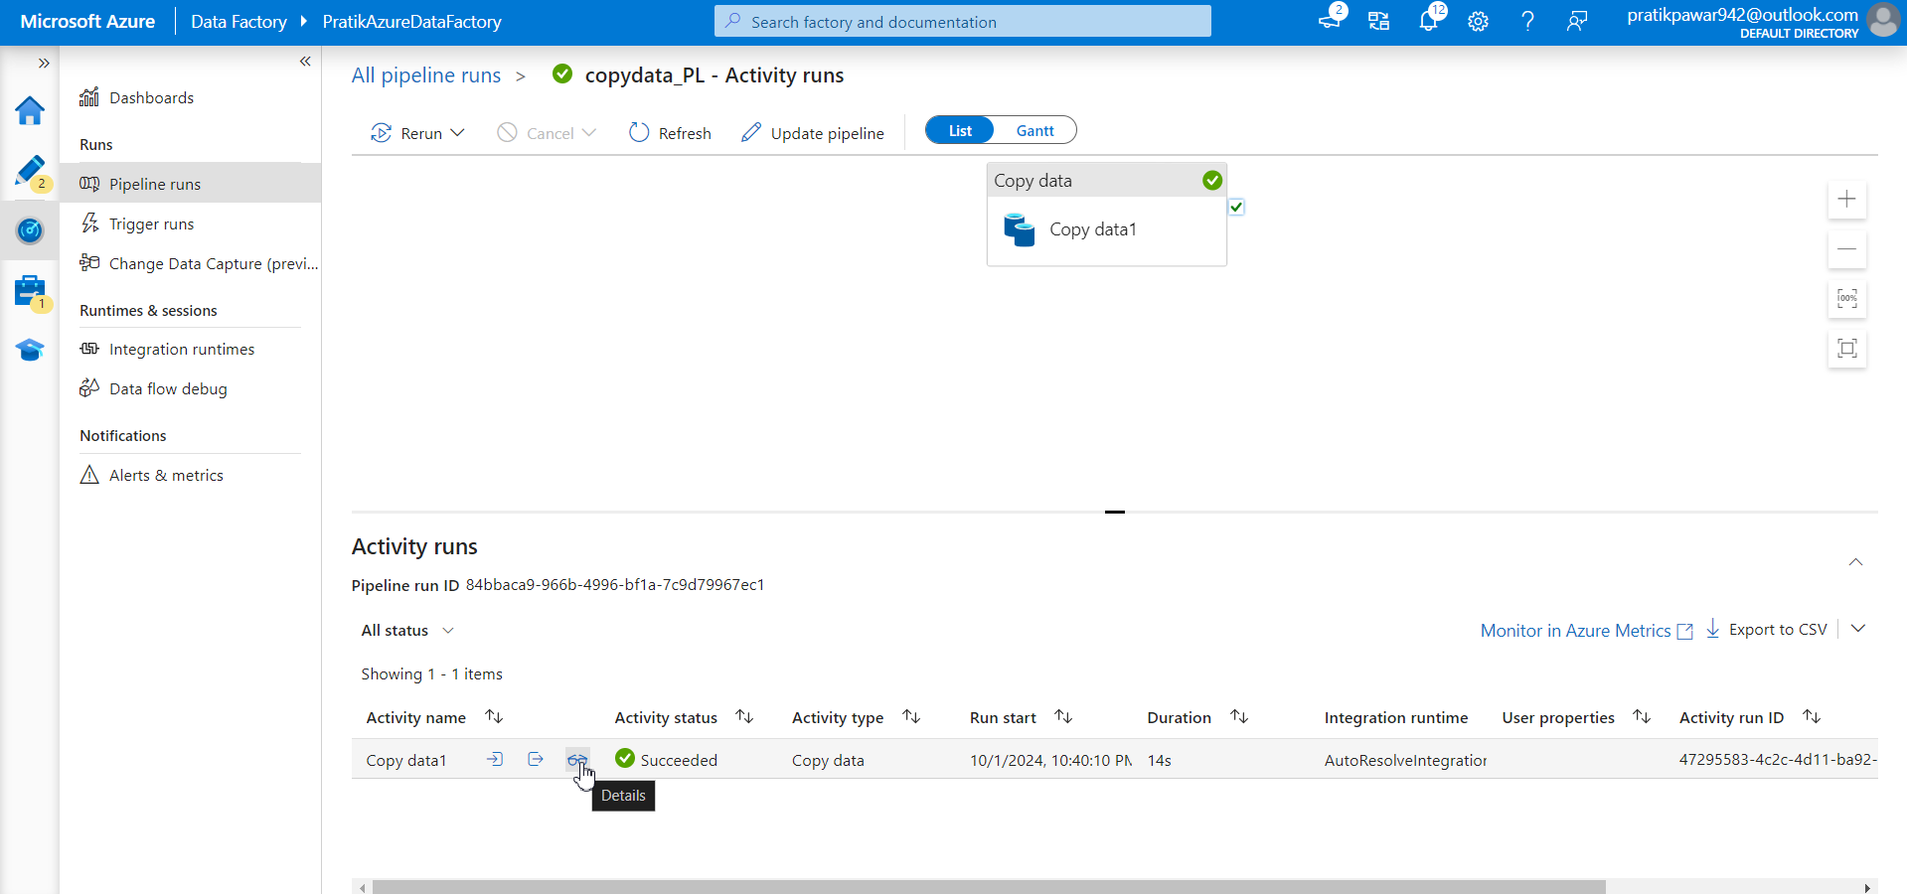
After Success just check details whether Files are Transferred or not

Slide 16
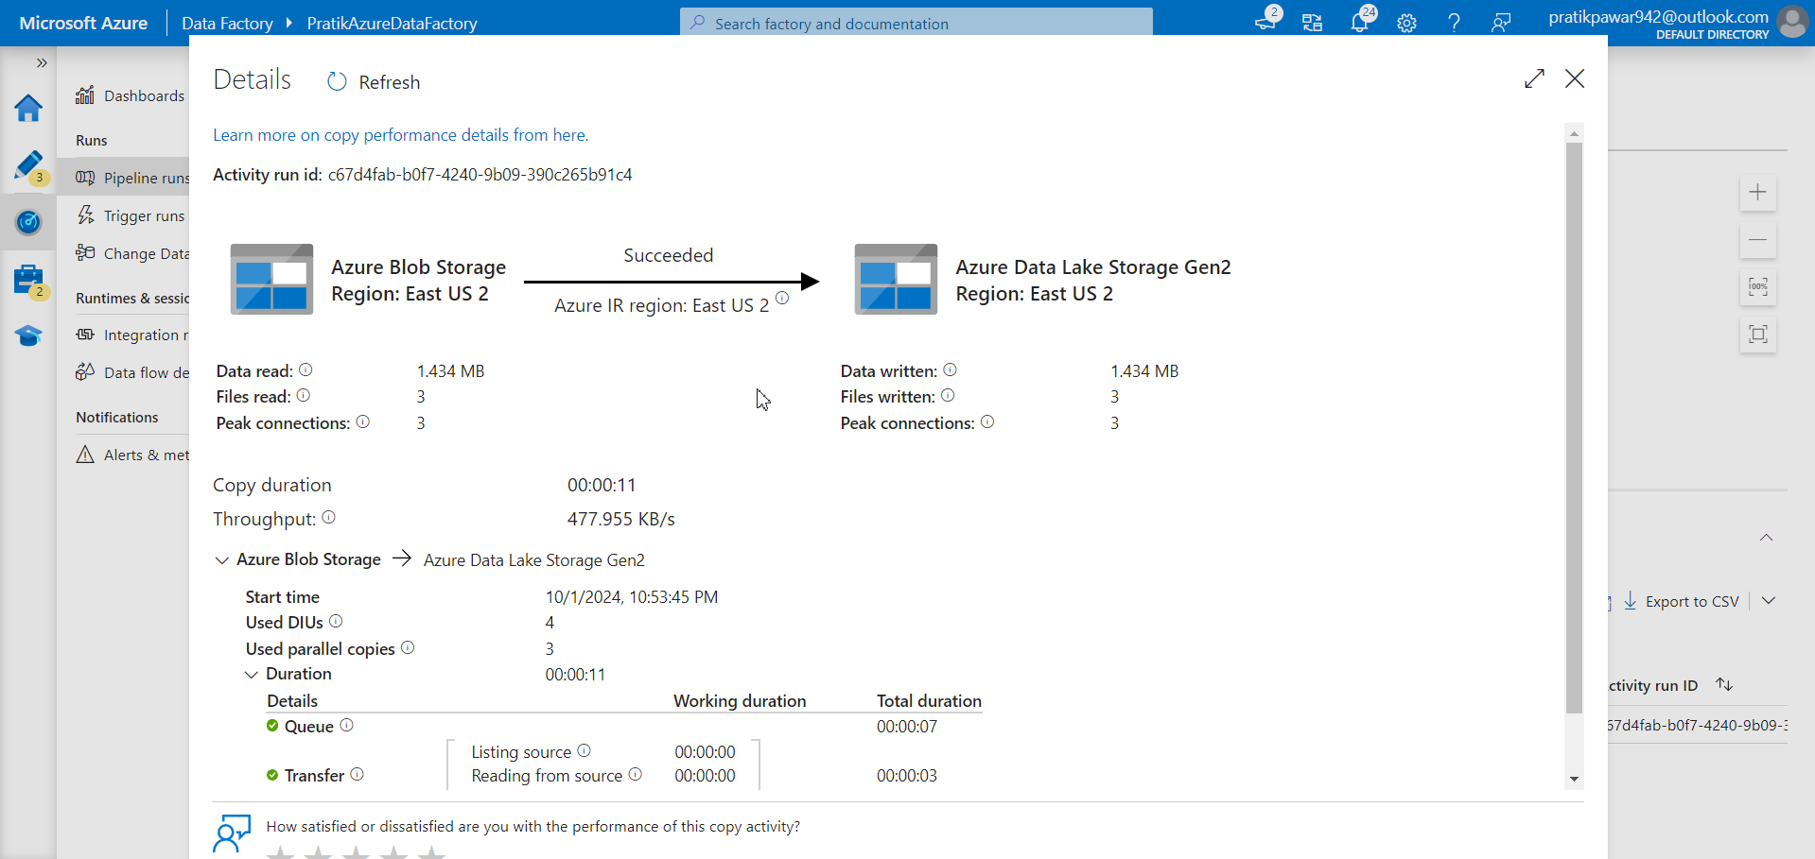
Succeeded all 3 files are written. But we want to load only particular/specific time files (like last 2 days or last 1 hours) which we will see in another ppt.

